Slide 1

IoT Army of 300
Resource Development to enable Our Brightest Minds in Technology
Abdur Rahman
Lecture 10
Serial Communication
Dec 13, 2017

Slide 2
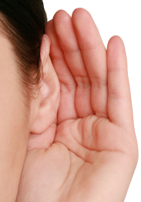

Serial Communication
MCU-2
Speaker
MCU-1
Speaker
Rx / Ear
Tx / Mouth
Data line
Data line
Rx / Ear
Tx / Mouth

Slide 3
USART
Introduction
AVR ATmega has flexible USART, which can be used for serial communication with other devices like computer, serial GSM, GPS modules etc.
Before beginning with AVR USART, we will walk though basics of serial communication.

Slide 4
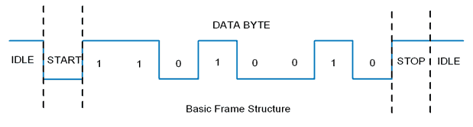
USART
Serial data framing:
While sending/receiving data, some bits are added for the purpose of knowing beginning/ending of data etc. commonly used structure is: 8 data bits, 1 start bit (logic 0) and 1 stop bit (logic 1), as shown:
There are also other supported frame formats available in UART, like parity bit, variable data bits (5-9 data bits).

Slide 5
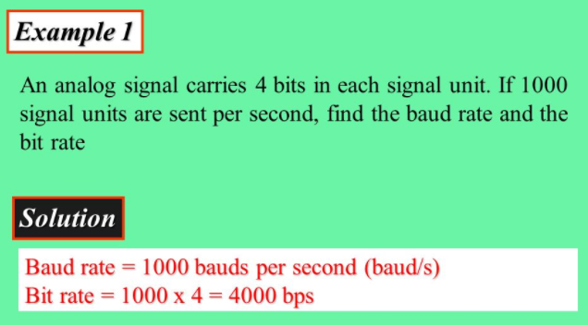
USART
Speed (Baud rate):
Baud rate refers to the number of signal or symbol changes that occur per second. A symbol is one of several voltage, frequency, or phase changes. In one symbol may contain more than one bit.
Bit Rate: refers to the number of bits—or the amount of data—that are processed over a certain amount of time.

Slide 6
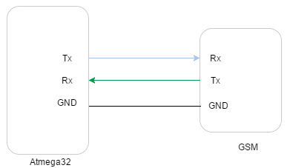
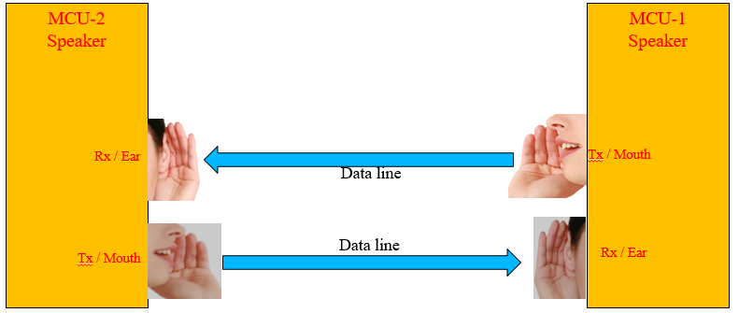
USART
Wires and Hardware connection:
Figure below shows the typical connection of a serial device with the MCU. There are basically Transmit(Tx) and Receive(Rx) lines and a common ground.

Slide 7
USART
Programming of USART in AVR
To program, first we need to understand basic registers used for USART
AVR basic Registers:
UDR: USART Data Register:
Actually this is not one but two register but when you read it you will get the data stored in receive buffer and when you write data to it goes into the transmitters buffer. This important to remember it.
2. UCSRA: USART Control and status Register A :
As the name suggests it is used to configure the USART and it also stores some status about the USART. In a similar fashion there are two more of this kind the UCSRB and UCSRC.
3. UBRRH and UBRRH (UBRR): This is the USART Baud rate register, it is 16BIT wide so UBRRH is the High Byte and UBRRL is Low byte. But as we are using C language it is directly available as UBRR and compiler manages the 16BIT access.

Slide 8
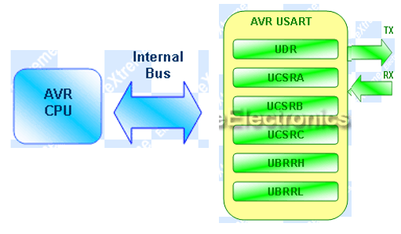
USART
the connection of AVR and its internal USART can be visualized as follows.

Slide 9
USART
Registers Explained:
In order to write programs that uses the USART you need to understand what each register’s importance. The scheme behind using the AVR USART is same as with any other internal peripheral (say ADC).
I am not going to repeat what is already there in the datasheets, I will just tell about what is required for a quick startup. The datasheets of AVR provides you with all the details of every bit of every register so please refer to it for detailed info. Note bit names with RED background are of our interest here.
UDR: Explained in slide no-7.

Slide 10
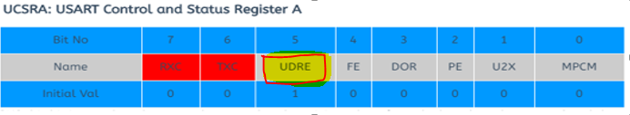
USART
Bit-7(RXC): this bit is set when the USART has completed receiving a byte from the host (may be your PC) and the program should read it from UDR
Bit-6(TXC): This bit is set (1) when the USART has completed transmitting a byte to the host and your program can write new data to USART via UDR
UDRE: USART Data Register Empty: If UDRE is 1 that means the buffer is empty and the UDR is ready to be written.

Slide 11
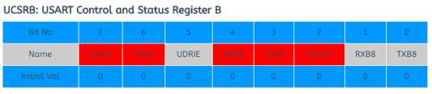
USART
RXCIE: Receive Complete Interrupt Enable – When this bit is written one the the associated interrupt is enabled.
TXCIE: Transmit Complete Interrupt Enable – When this bit is written one the the associated interrupt is enabled.
RXEN: Receiver Enable – When you write this bit to 1 the USART receiver is enabled. The normal port functionality of RX pin will be overridden. So you see that the associated I/O pin now switch to its secondary function,i.e. RX for USART.
TXEN: Transmitter Enable – As the name says!
UCSZ2: USART Character Size – Discussed later.
we won’t be using interrupts so we set UCSRB as : UCSRB=(1<<RXEN)|(1<<TXEN);

Slide 12
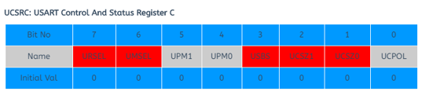
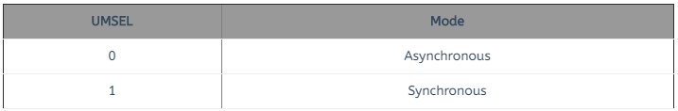
USART
IMPORTANT : The UCSRC and the UBRRH (discussed below) register shares same address so to determine which register user want to write is decided with the 7th(last) bit of data if its 1 then the data is written to UCSRC else it goes to UBRRH. This seventh bit is called the
URSEL: USART register select.
UMSEL: USART Mode Select – This bit selects between asynchronous and synchronous mode. As asynchronous mode is more popular with USART we will be using that.

Slide 13
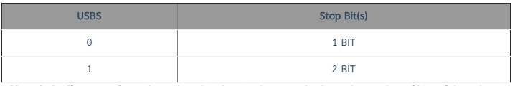
USART
USBS: USART Stop Bit Select – This bit selects the number of stop bits in the data transfer.

Slide 14
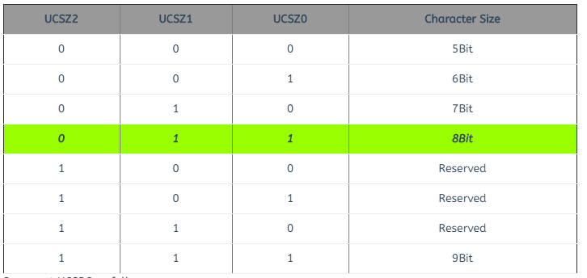
USART
UCSZ: USART Character size – These three bits (one in the UCSRB) selects the number of bits of data that is transmitted in each frame. Normally the unit of data in MCU is 8BIT (C type "char") and this is most widely used so we will go for this. Otherwise you can select 5,6,7,8 or 9 bit frames!
So we set UCSRC as follows:
UCSRC=(1<<URSEL)|(3<<UCSZ0);

Slide 15

USART
UBRR: USART Baud Rate Register:
This is the USART Baud rate register, it is 16BIT wide so UBRRH is the High Byte and UBRRL is Low byte. But as we are using C language it is directly available as UBRR and compiler manages the 16BIT access. This register is used by the USART to generate the data transmission at specified speed (say 9600Bps). UBRR value is calculated according to following formula.
Where System Clock or fosc is CPU frequency say 16MHz or 8MHZ or 1MHZ
Baud Rate is the required communication speed say 9600, 4800

Slide 16
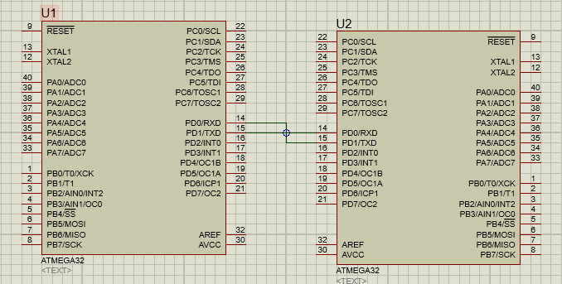
USART
Initializing USART:
Setting the BAUD rate // UBRR
Setting Data Size //UCSRC
Setting Parity bit and number of stop bits //UCSRC
Enable Reception and Transmission //UCSRB
Writing(Tx) or Reading(Rx) Data //UDR, UCSRA

Slide 17
USART

Slide 18
USART

